Slide 1



EDUBRIDGE LEARNING PVT LTD
EDUBRIDGE LEARNING PVT LTD
PRESENTATION ON
ONLINE EXAMINATION SYSTEM
PRESENTED BY
Karan Mohan Mane
UNDER GUIDANCE OF
Prof. Rohit Sutare
ACADEMIC YEAR 2022-23

Slide 2

CONTENTS
CONTENT
Introduction
Technologies Used
Architecture
CURD Operations
Screenshots
Spring Boot Application
MySQL Code
Frontend-Angular
Postman-API Testing
Conclusion
Future Enhancement
GitHub Link

Slide 3
INTRODUCTION
Online Examination System often referred to as an online testing or e-assessment system, is a digital platform designed to facilitate the creation, administration, and evaluation of tests, quizzes, assessments, or exams via the internet. It has gained significant popularity in recent years due to its convenience, scalability, and efficiency, particularly in educational institutions, corporate training, and certification programs.
In summary, online examination systems offer a flexible, secure, and efficient way to conduct assessments and examinations in various educational and professional settings. They leverage technology to streamline the testing process, improve accessibility, and provide valuable insights into participant performance.

Slide 4
TECHNOLOGIES USED
Angular
CLI
MySQL
Full Stack Application
JPA
Hibernet
Spring Boot Framework

Slide 5
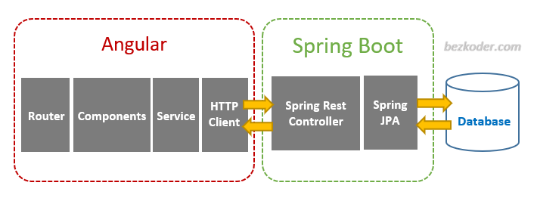
ARCHITECTURE

Slide 6
CURD OPERATIONS
Admin
Add Exam
Create
Admin
Update Exam
Update
Admin
View Exam
Read
Admin
Delete Exam
Delete
Admin
Add Question
Create
Admin
View User
Read
User
View Question
Read

Slide 7
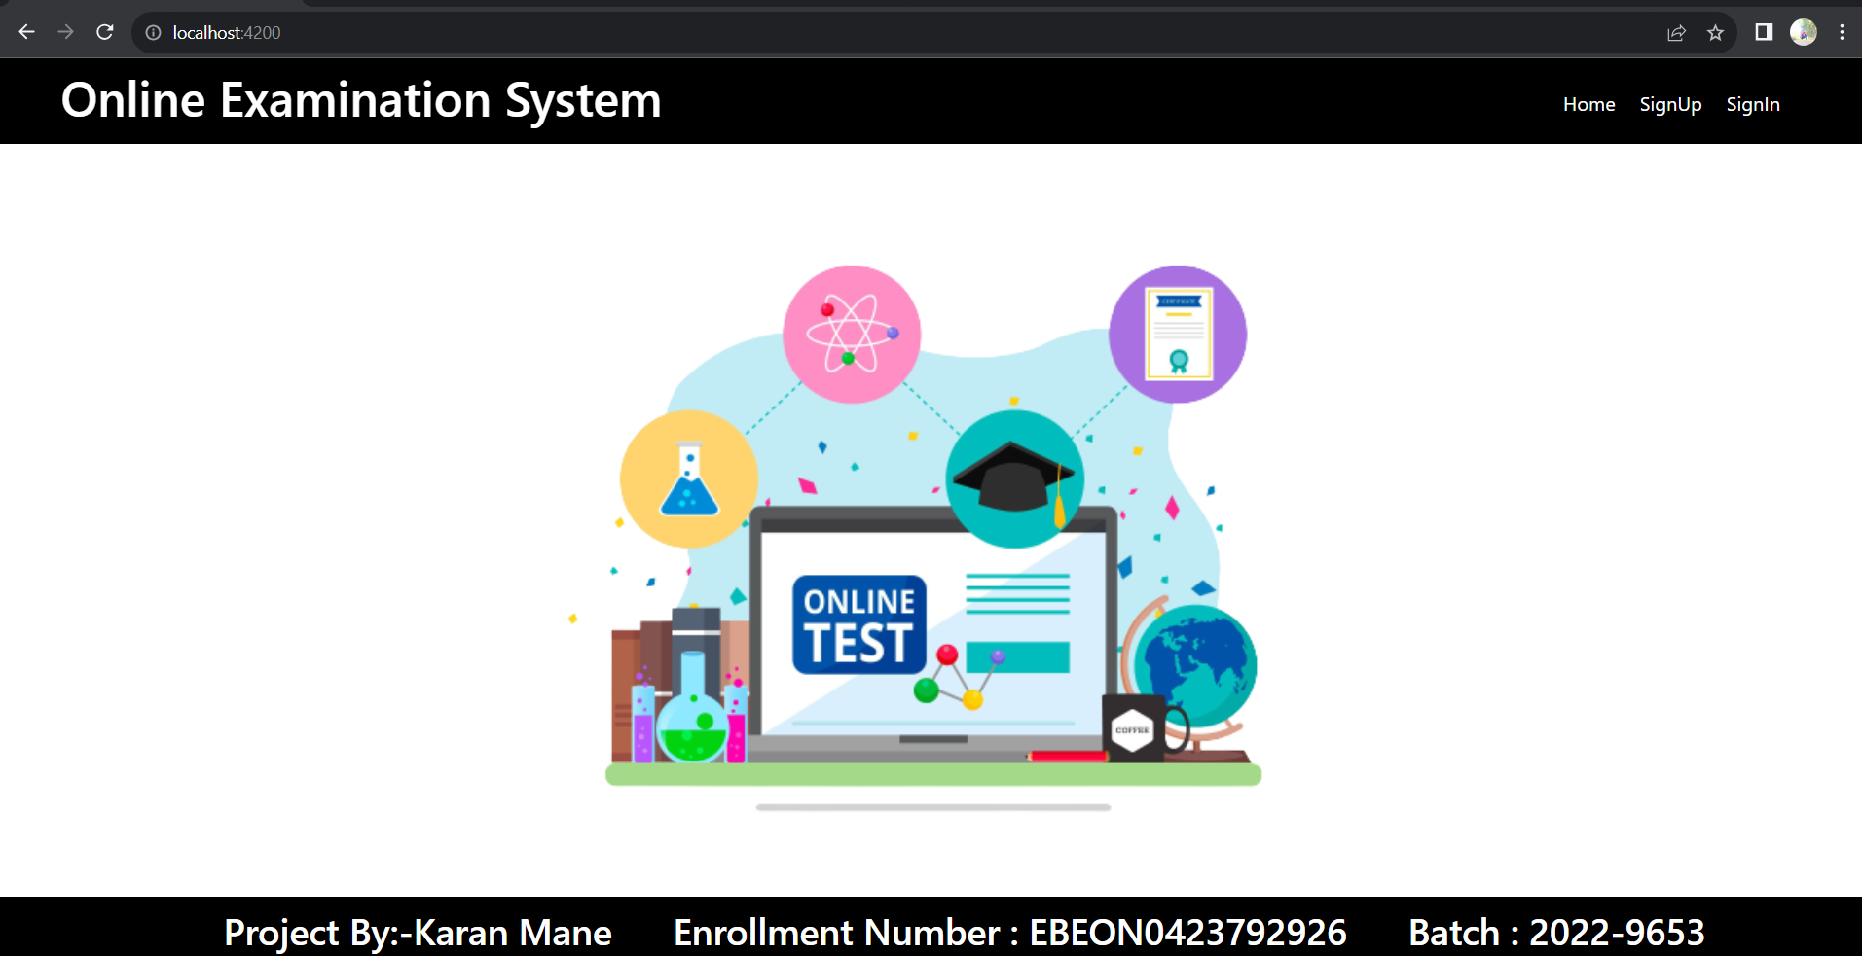
USER HOME PAGE

Slide 8
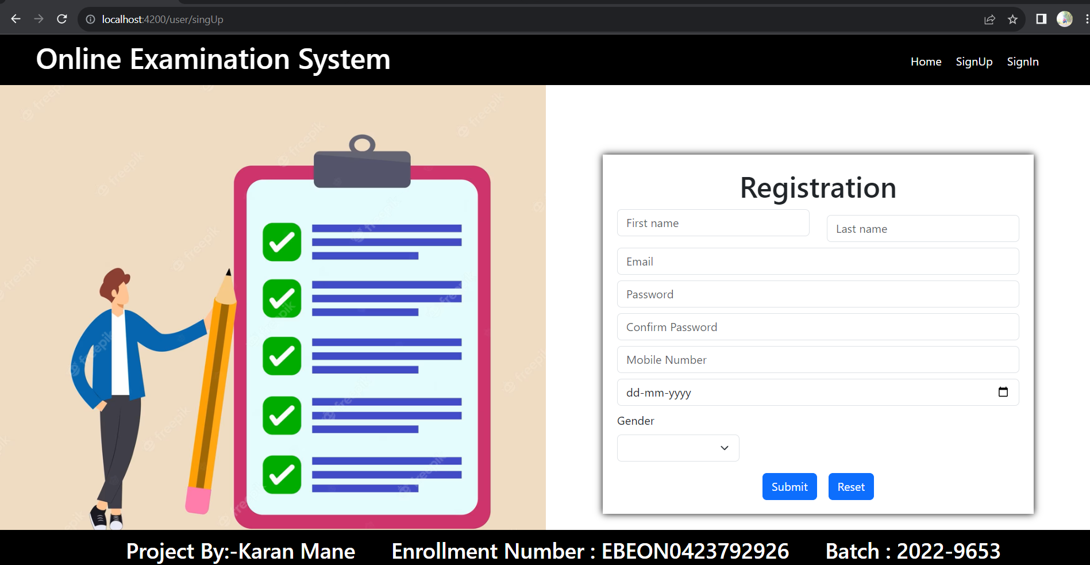
USER REGISTRATION

Slide 9
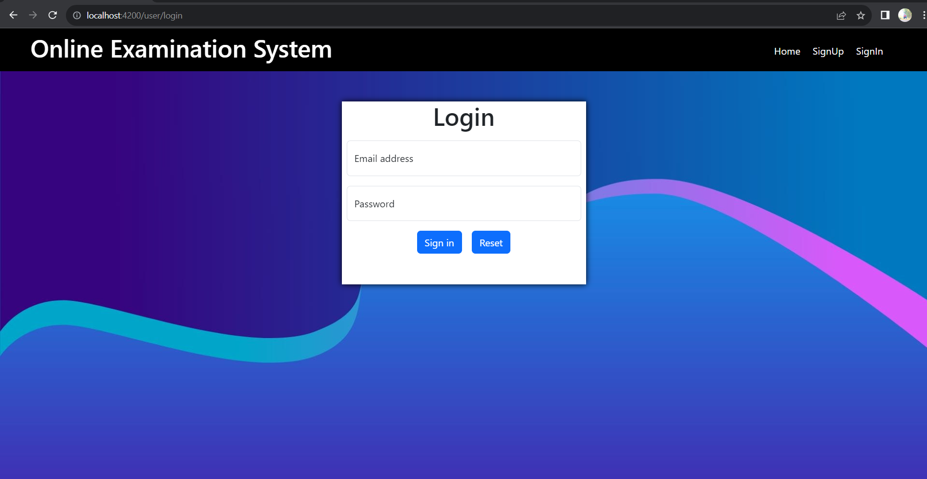
USER LOGIN

Slide 10
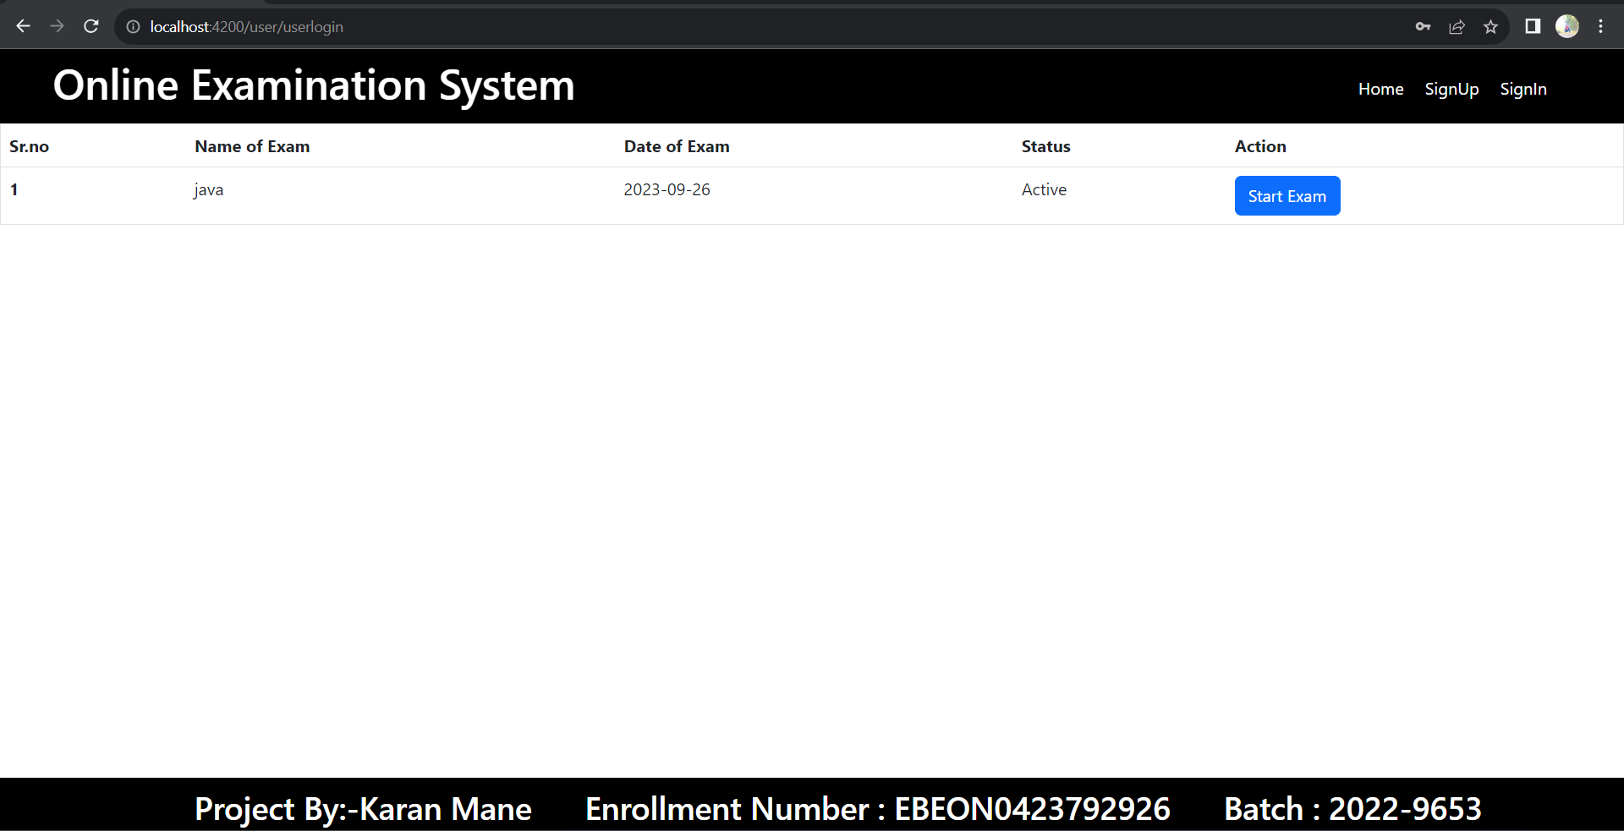
USER EXAM LIST

Slide 11
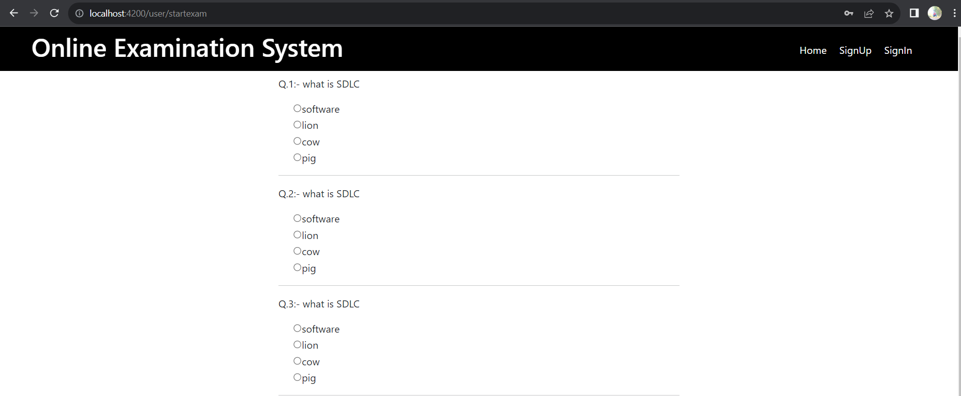
USER EXAM

Slide 12
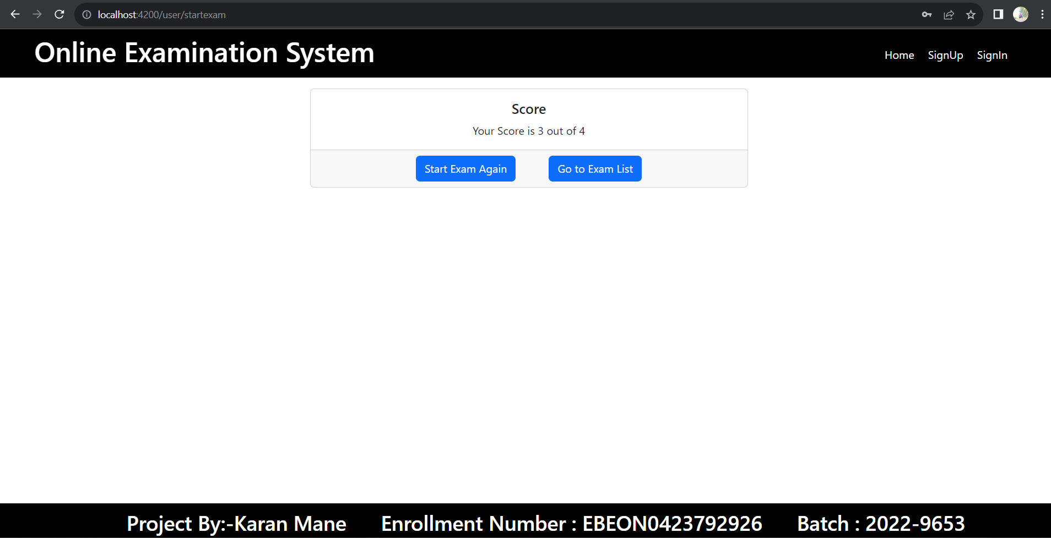
USER SCORE

Slide 13
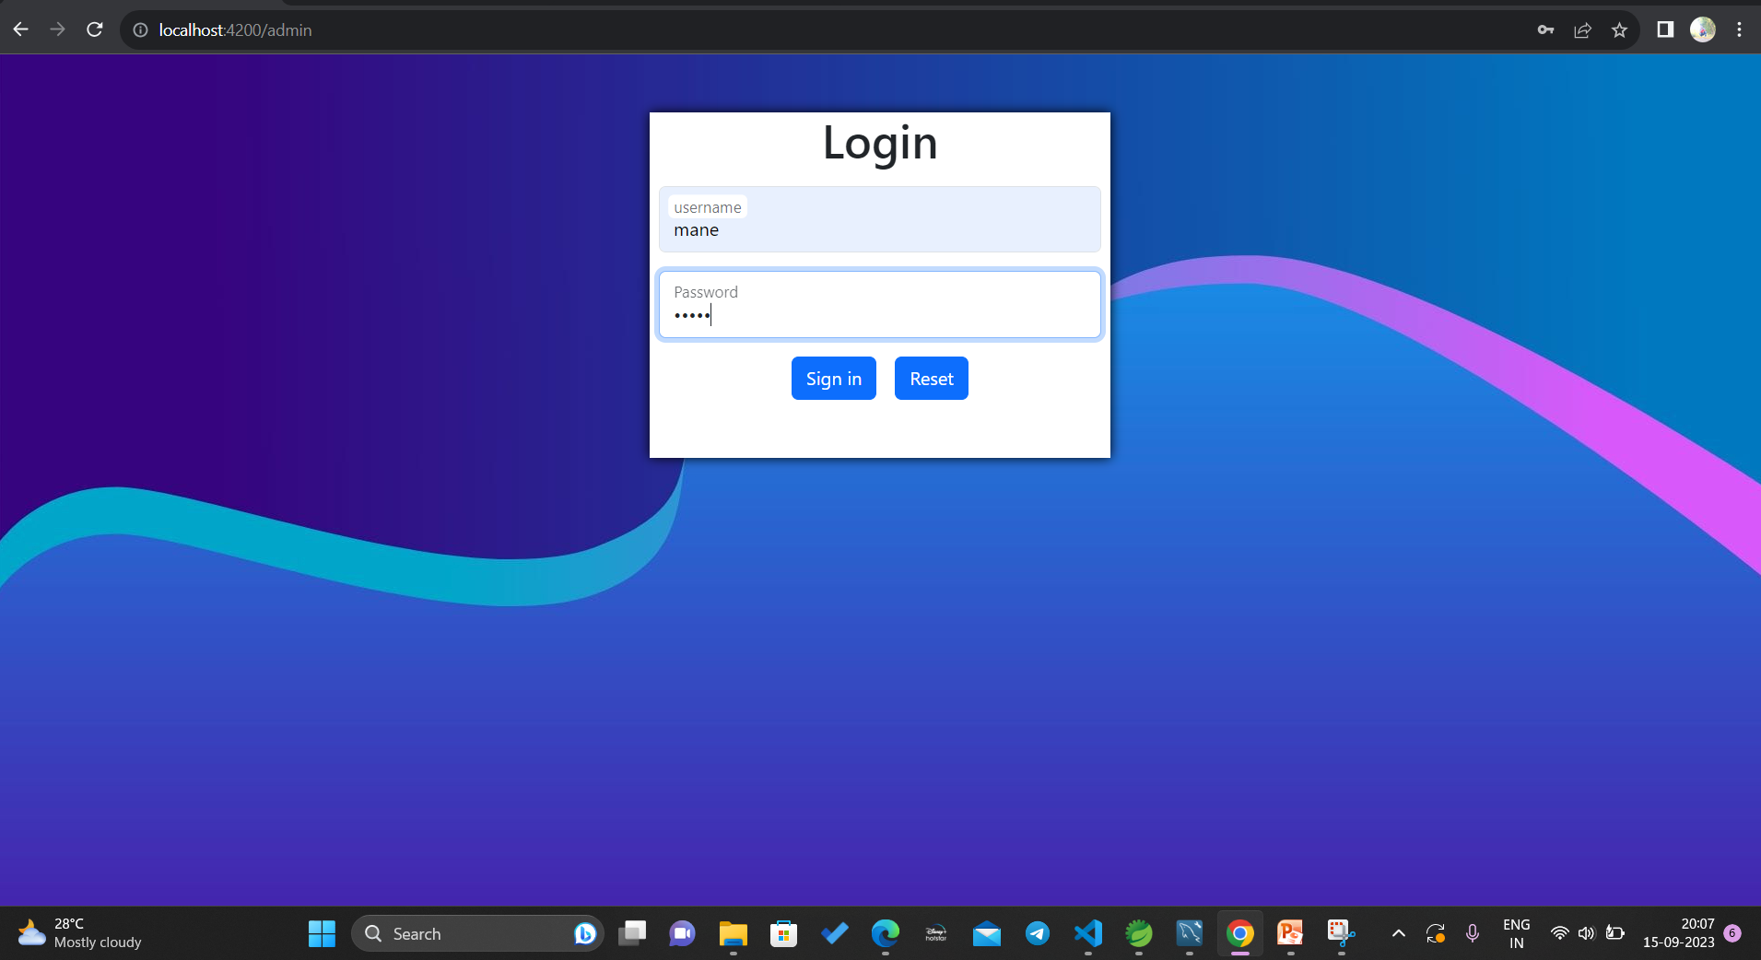
ADMIN LOGIN

Slide 14
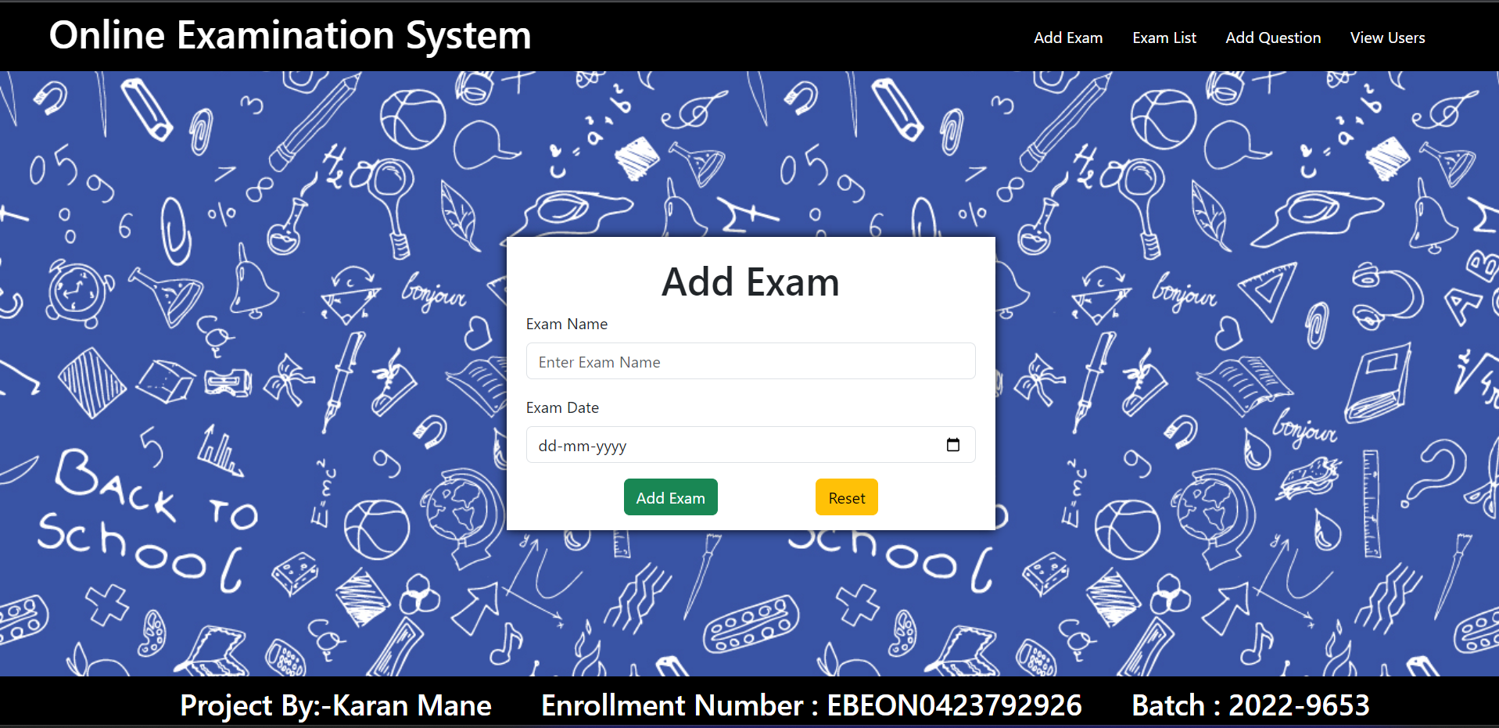
ADMIN ADD EXAM

Slide 15
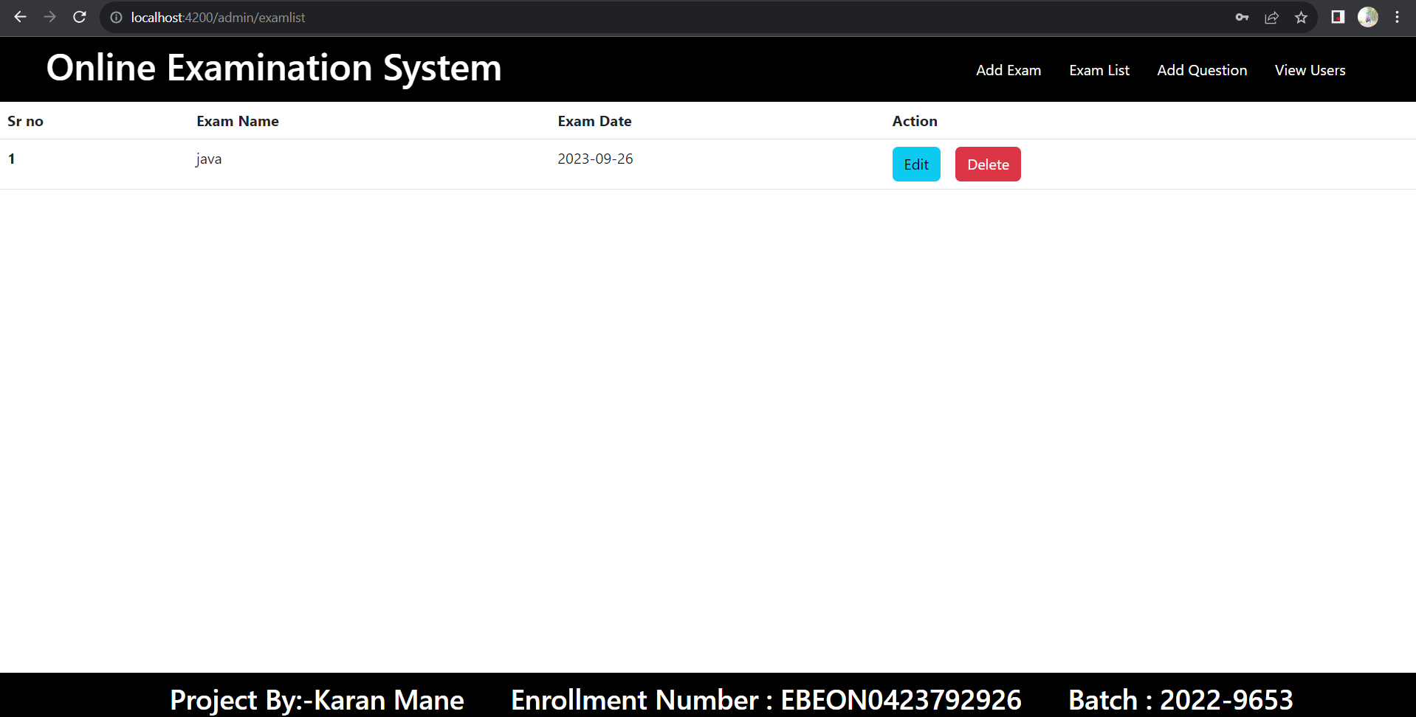
ADMIN EXAM LIST

Slide 16
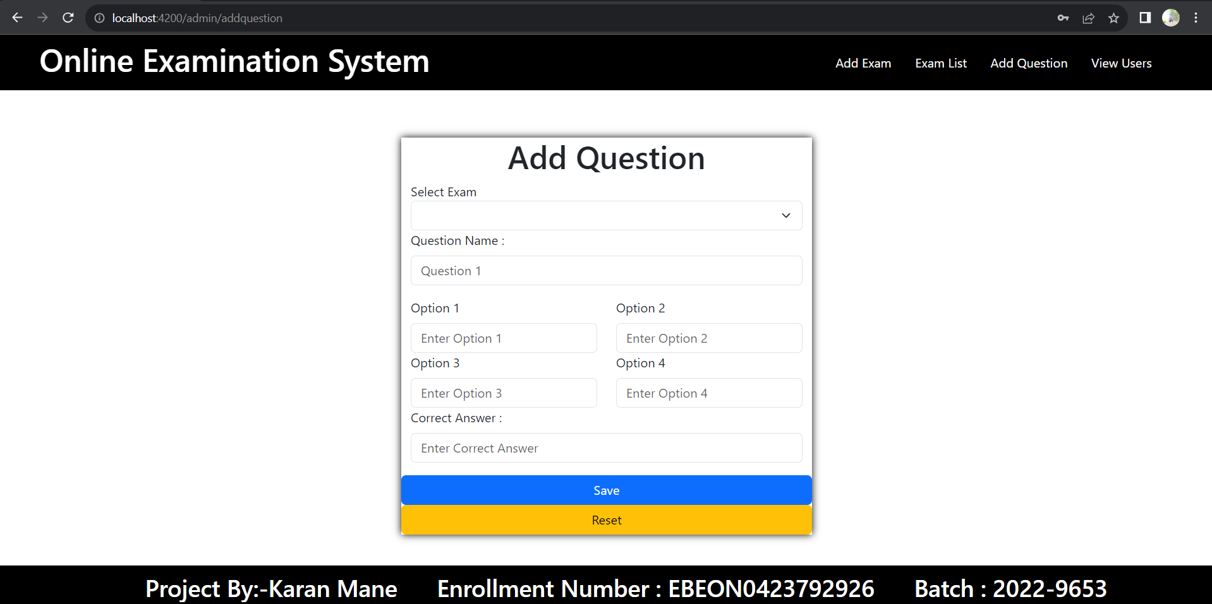
ADMIN ADD QUESTIONS

Slide 17
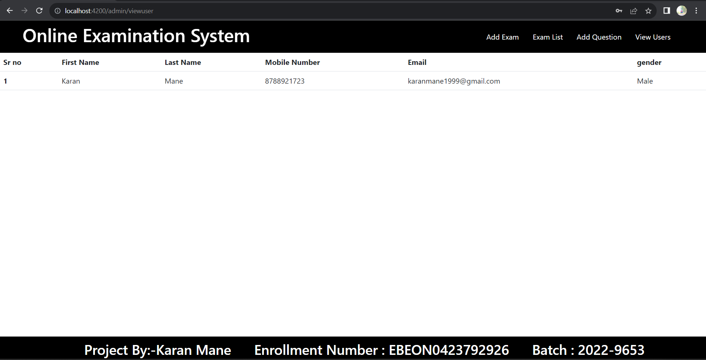
ADMIN VIEW USER

Slide 18
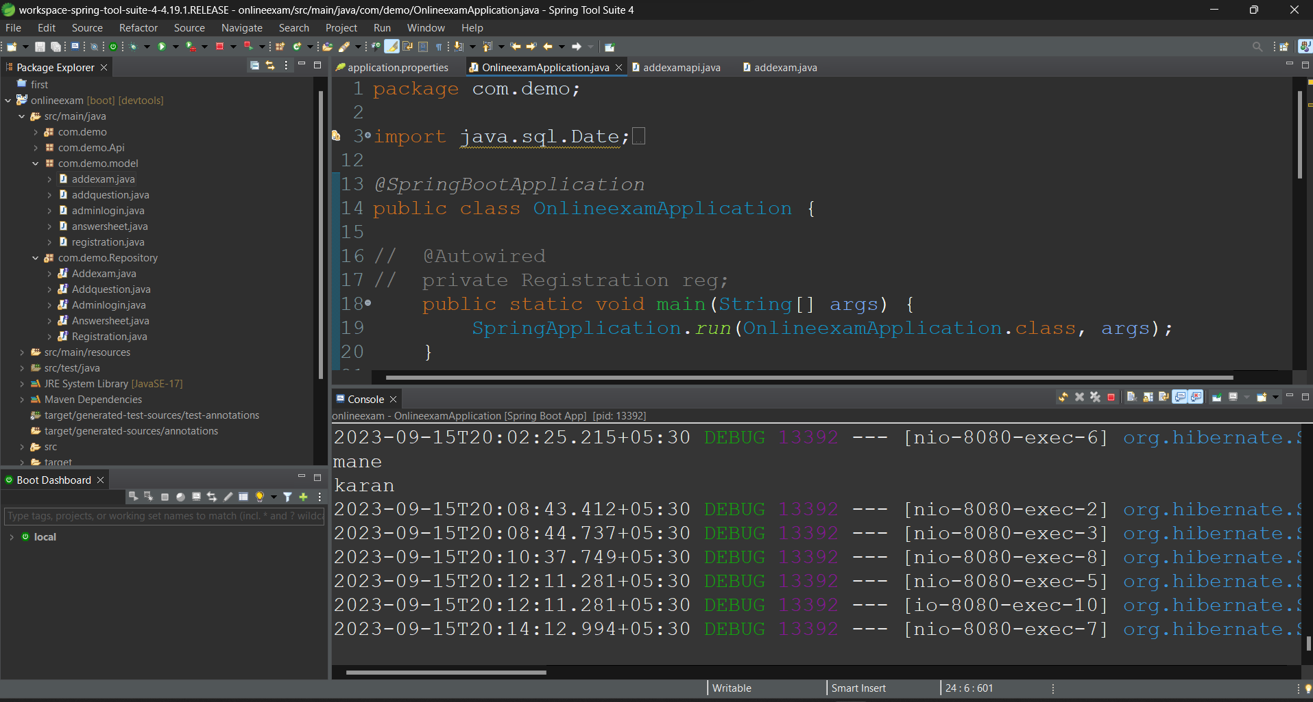
SPRING BOOT APPLICATION

Slide 19
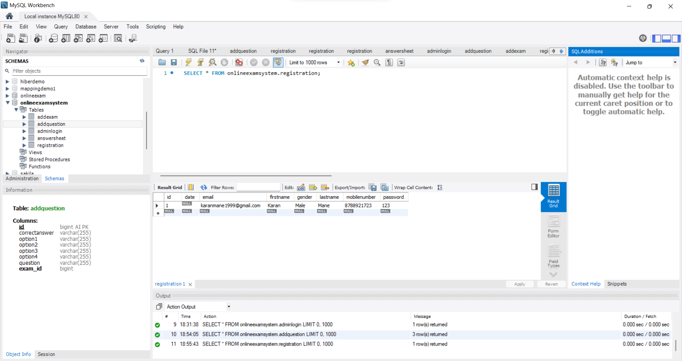
MySQL

Slide 20
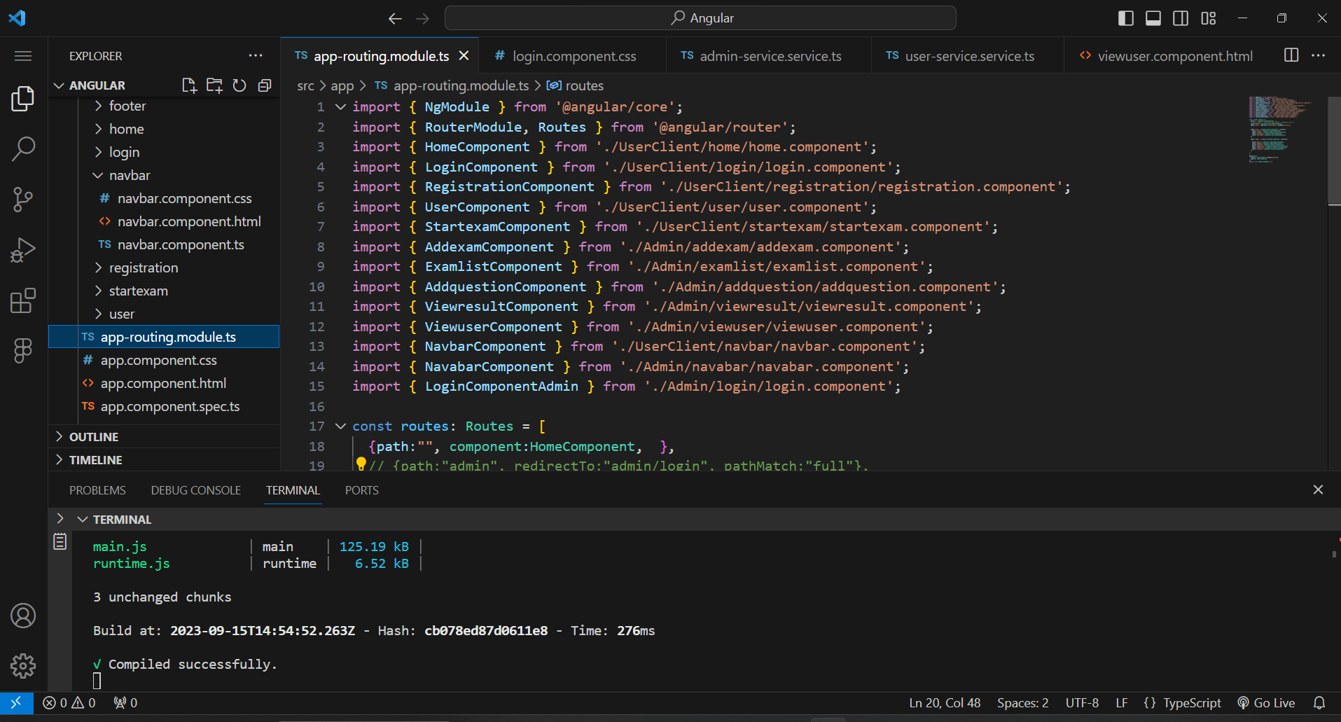
ANGULAR

Slide 21
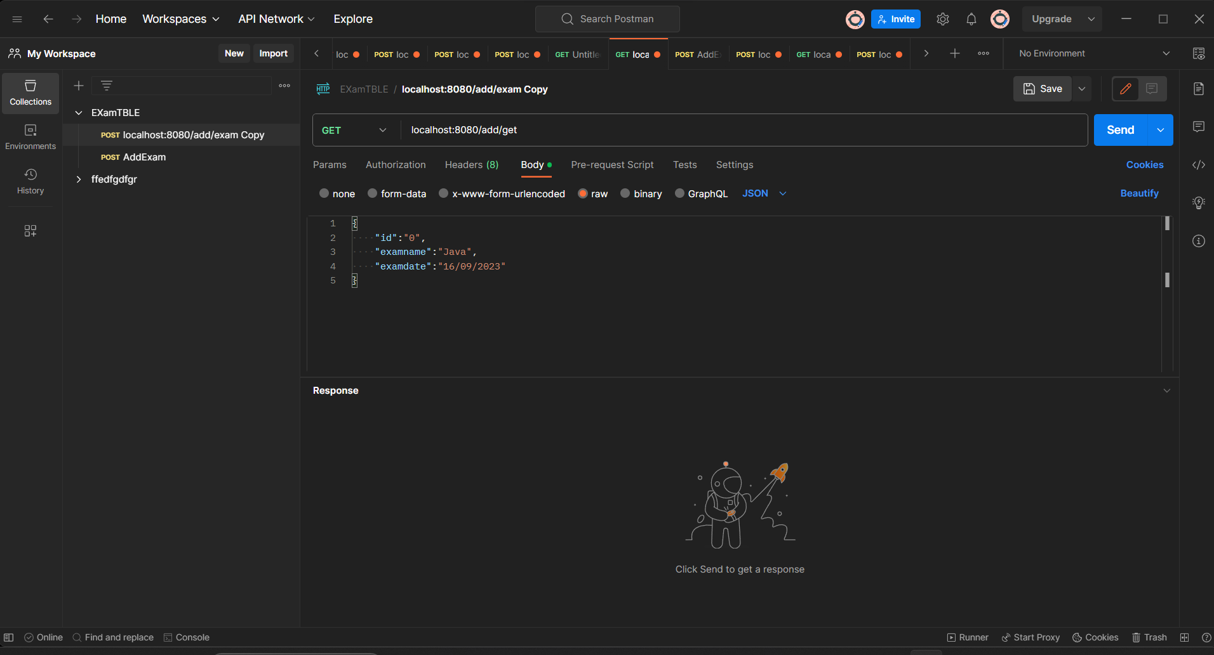
POSTMAN
API-Testing

Slide 22
CONCLUSION
online examination systems offer convenience, scalability, security, and data-driven insights, revolutionizing the assessment process in education and corporate settings. They enhance efficiency, reduce costs, and promote accessibility, making them indispensable tools for modern evaluation needs.

Slide 23
FUTURE ENHANCEMENT
The future of online examination systems holds several exciting possibilities for enhancement and improvement. Here are some potential areas of development:
AI-Powered Proctoring: Further advancement in artificial intelligence can enhance remote proctoring capabilities. AI can better detect cheating behaviors and ensure the integrity of online exams, making it even more reliable and accurate.
Blockchain for Security: Integration with blockchain technology can provide an immutable and transparent record of exam results, enhancing the security and trustworthiness of the system.
Adaptive Testing: Enhanced algorithms can create adaptive tests that adjust the difficulty of questions based on the participant's responses. This ensures a more accurate assessment of knowledge and skills.
Virtual Reality (VR) Exams: The integration of VR technology can create immersive exam experiences, particularly in fields where hands-on skills are crucial, such as healthcare or engineering.

Slide 24
THANK YOU..!

